Slide 1
You Can Judge a Book By Its Cover!
Sarah Glogowski
Executive Director
Finger Lakes Library System

Slide 2
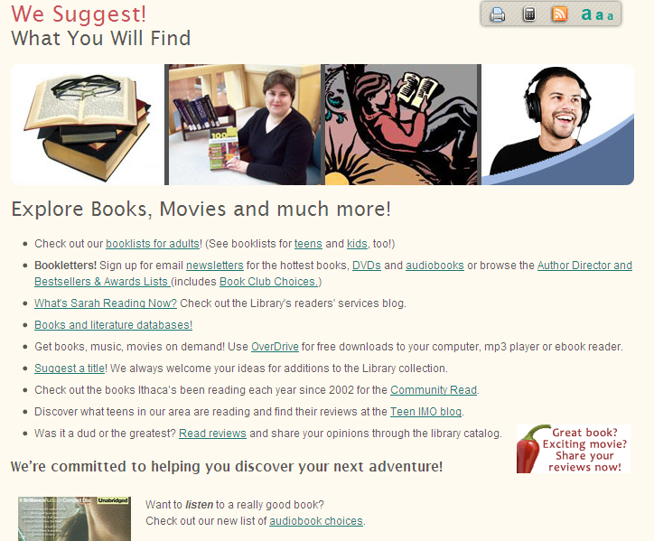
What is Readers’ Advisory?
Quite simply, it is the act of putting people together with books they love.

Slide 3
Author’s Name versus Title

Slide 4
Author’s Name versus Title

Slide 5
The Making of a Cover

Slide 6
The Making of a Cover

Slide 7
The Paperback Cover

Slide 8
Mysteries - Cozies

Slide 9
Mysteries - Historical

Slide 10
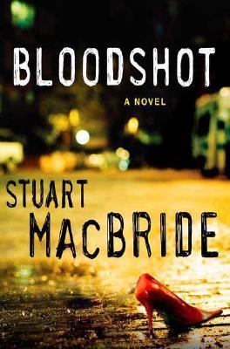
Mysteries - Dark

Slide 11
Mysteries - Scandinavian

Slide 12
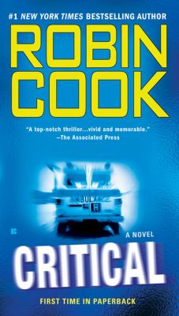
Thrillers

Slide 13
Suspense

Slide 14
Inspirational Fiction

Slide 15
Women’s Fiction

Slide 16
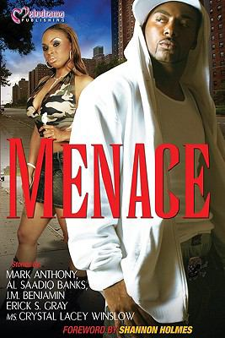
Street Lit

Slide 17
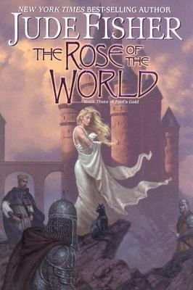
Fantasy

Slide 18
Urban Fantasy

Slide 19
Science Fiction

Slide 20
Romance

Slide 21
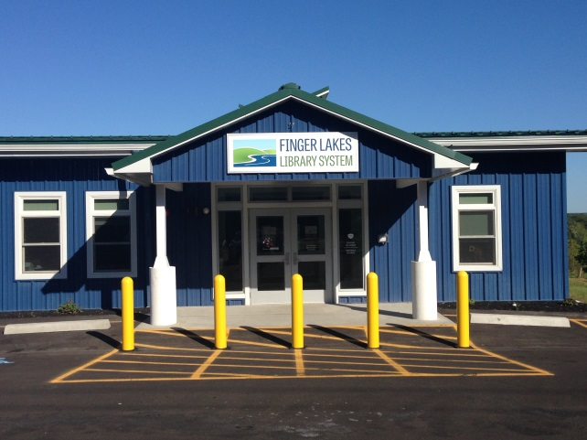
Contact
Need help finding your next book? Want recommendations on different authors or genres?
Email sglogowski@flls.org
Phone: 607 273 4074 ext. 222

