Slide 1
NoveList and NoveList Plus Overview
Finger Lakes Library System

Slide 2
NoveList is for…
READERS
LIBRARIANS
TEACHERS, PARENTS, ANYONE WHO WORKS WITH READERS
Help finding the right books
Reading recommendations, lists, and more
Fresh content, including popular books and topics
Readers’ advisory tools and guides
Advanced searching and filtering to help readers find books
Find quick answers to meet demand
Easy to use

Slide 3
NoveList
NoveList Plus
Fiction for all ages and grades
Fiction and nonfiction for all ages and grades, and audiobooks

Slide 4
NoveList vs. NoveList Plus

Slide 5
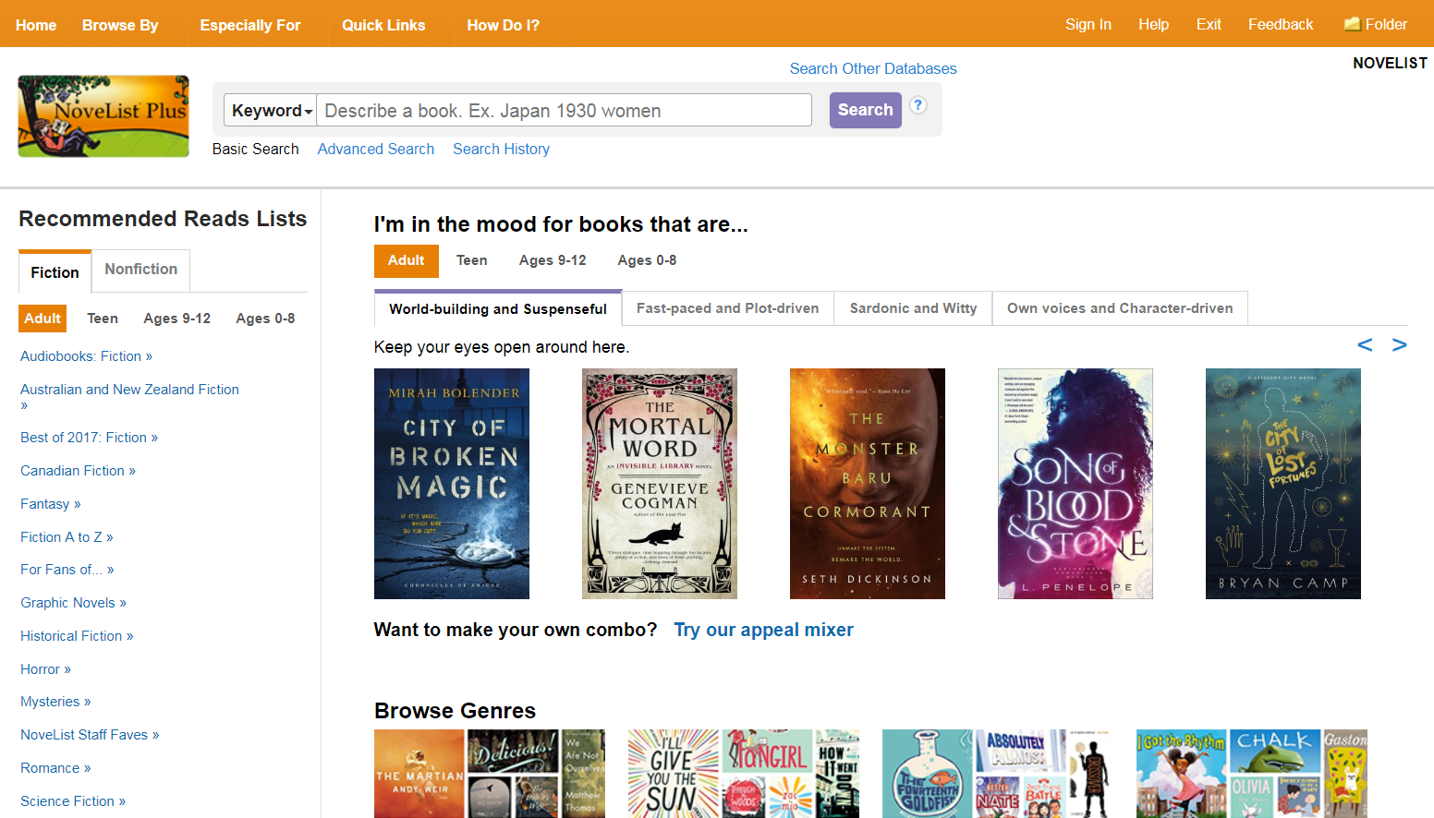
The search bar appears on each page in NoveList
Browse for books by Appeal terms combinations.
Recommended Reads
And find books by genre

Slide 6
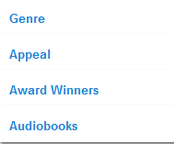
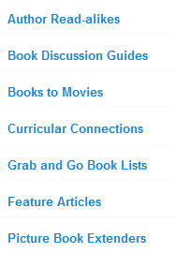
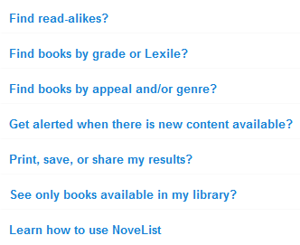
The NoveList Toolbar
Access a variety of helpful resources from anywhere in the product.

Slide 7
Basic Search
Keyword: searches most fields across all records and returns results grouped in tabs by type of record (Books, Series, Authors, Lists & Articles). Note that you can use this search for “Describe a Plot” searching.
Title
Author
Series
Narrator
Search Other Databases: Allows you to access any of your library’s EBSCO databases without having to return to your library’s website. Clicking this link will take you to a list of the products to which your library subscribes.

Slide 8
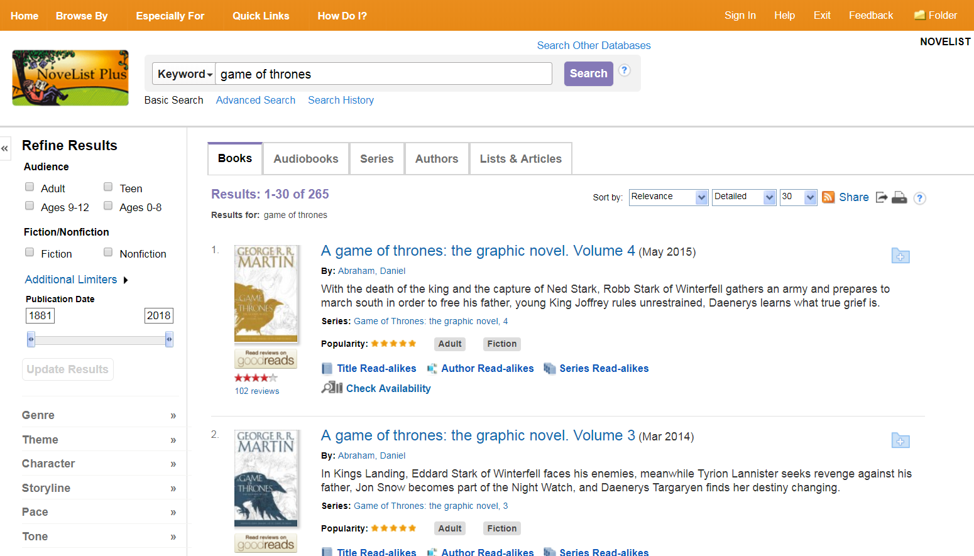
Viewing Results
Results tab
Limiters
Clustering

Slide 9
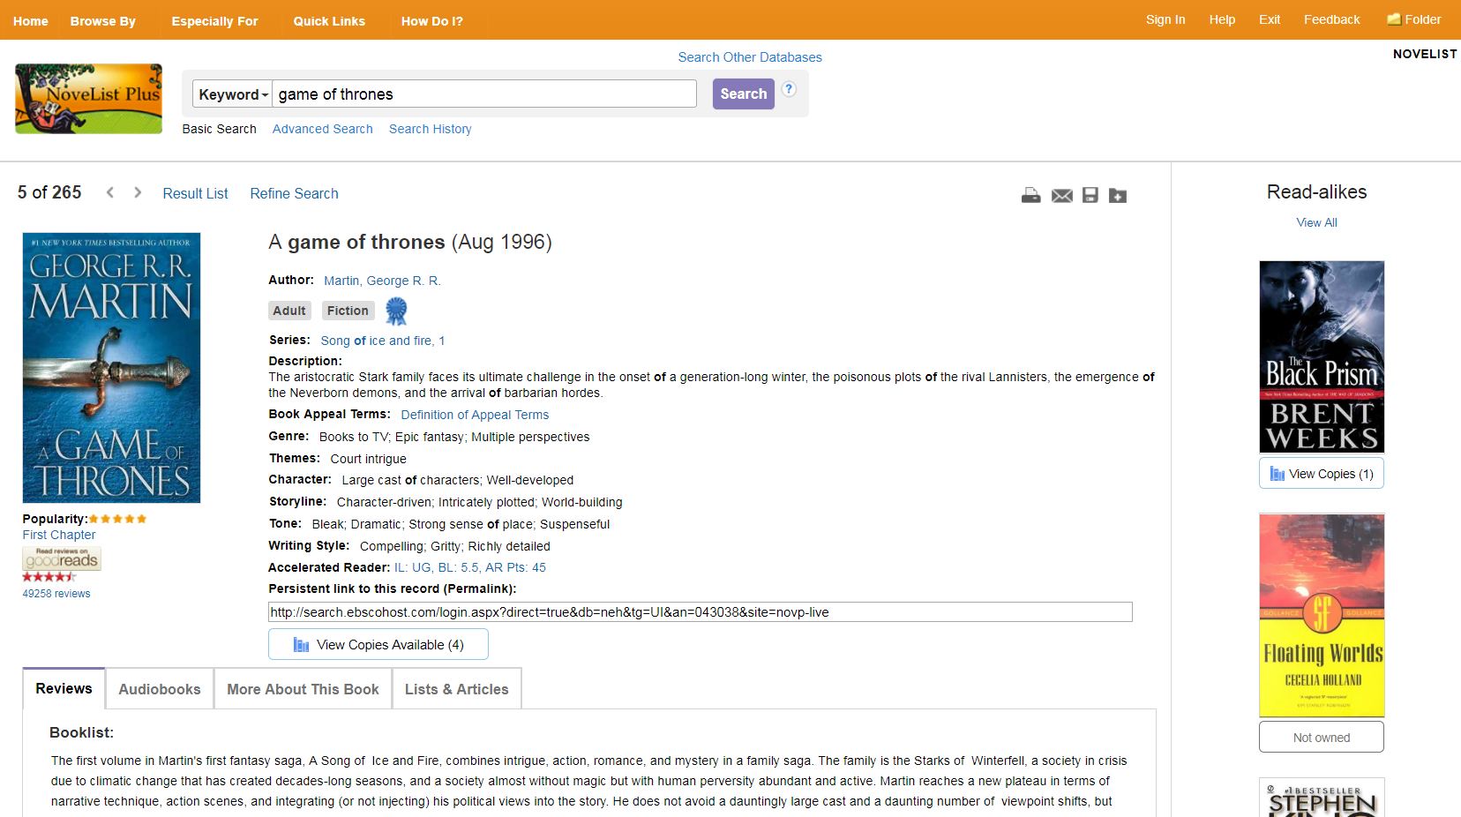
Viewing an Item
Basic Information, including appeal and theme terms
Read-alikes from NoveList
Tabs

Slide 10
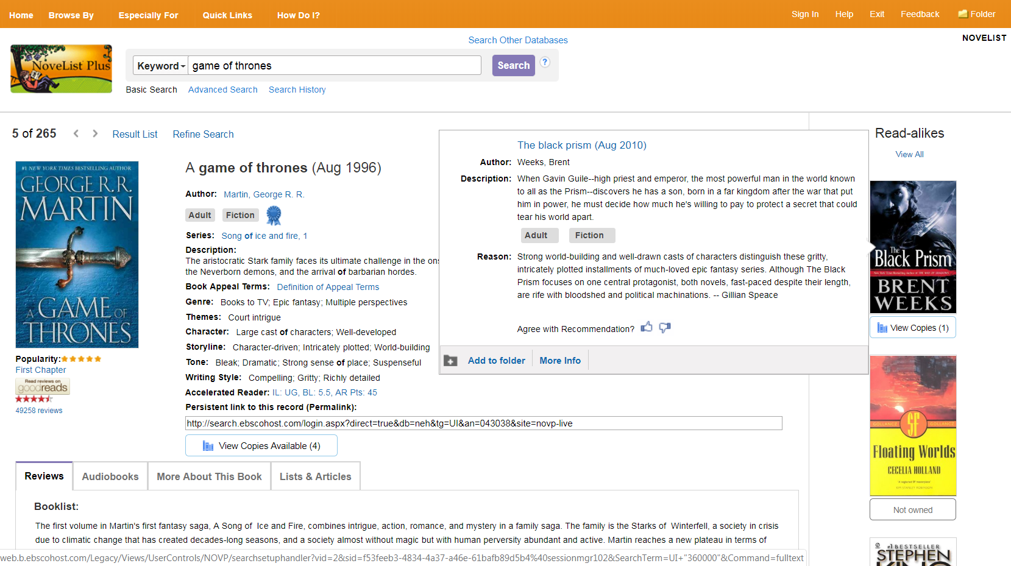
Thumbs Up/ Down
See why a title was recommended. If you agree or disagree with the read-alike, you can share your thoughts with NoveList.

Slide 11
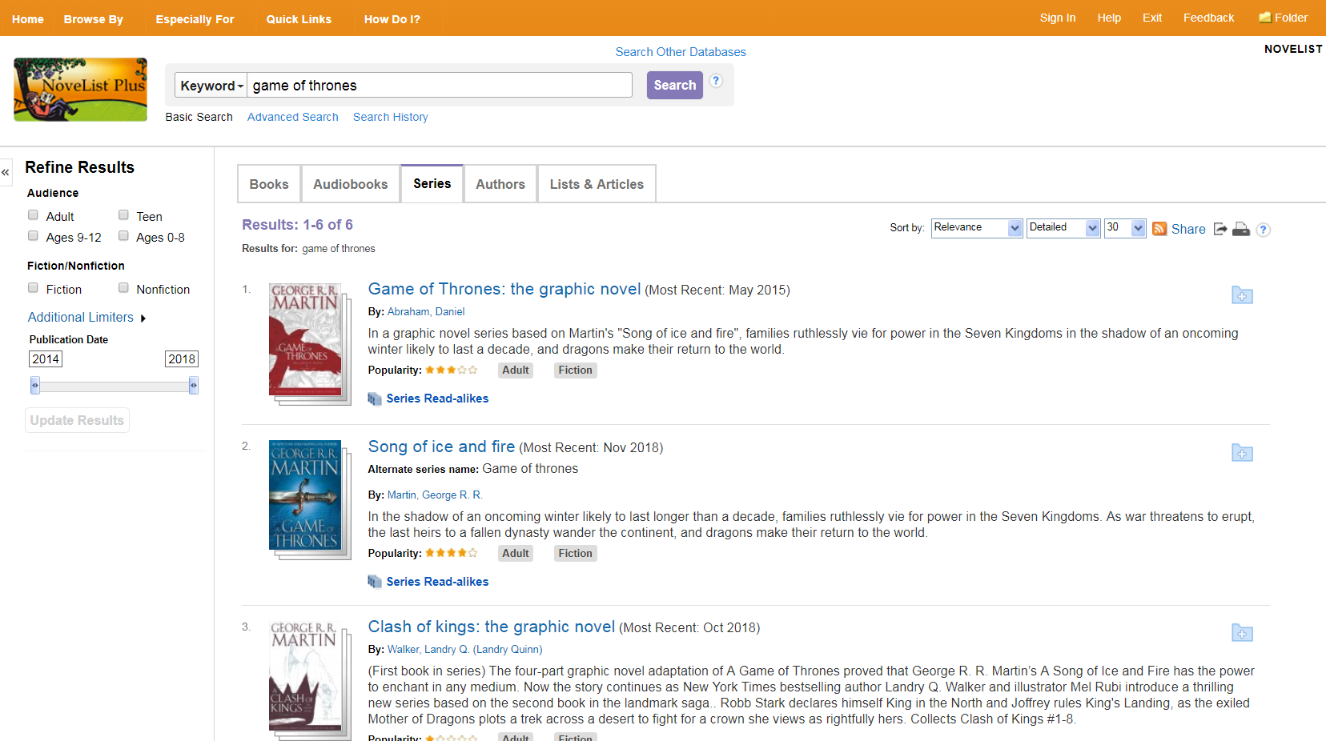
Searching for a Series
Enter your keywords
Click the Series tab
Select the series

Slide 12
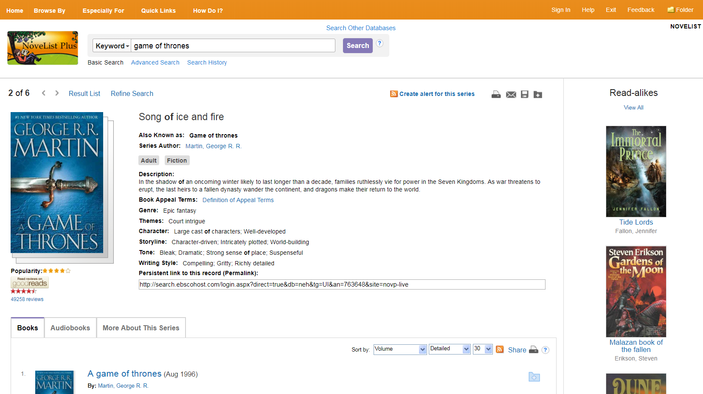
Series Information

Slide 13
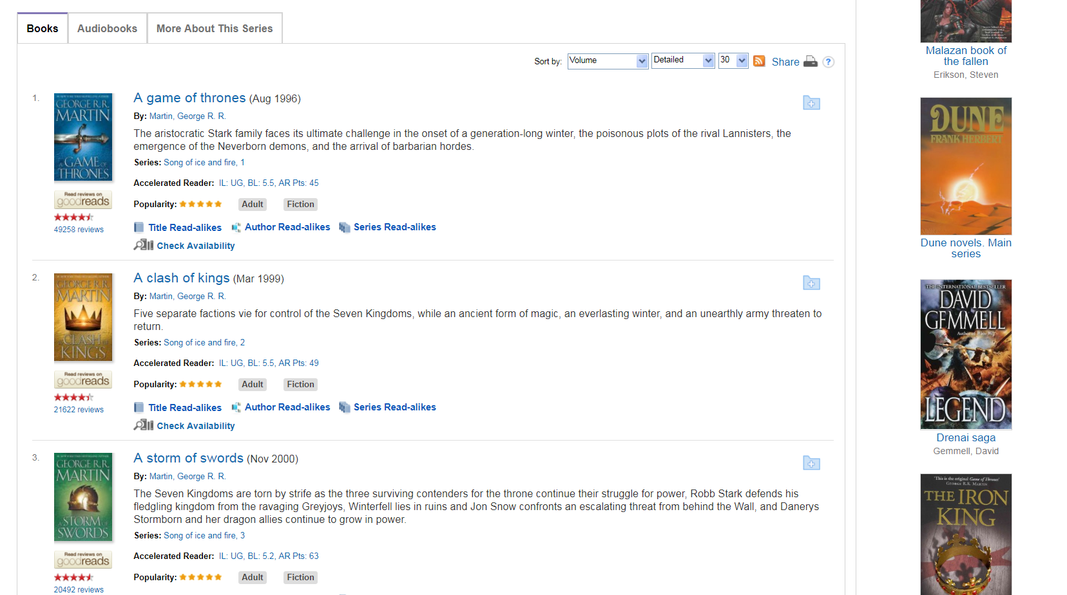
Books in the Series

Slide 14
Up to 9 read-alikes for a series

Slide 15
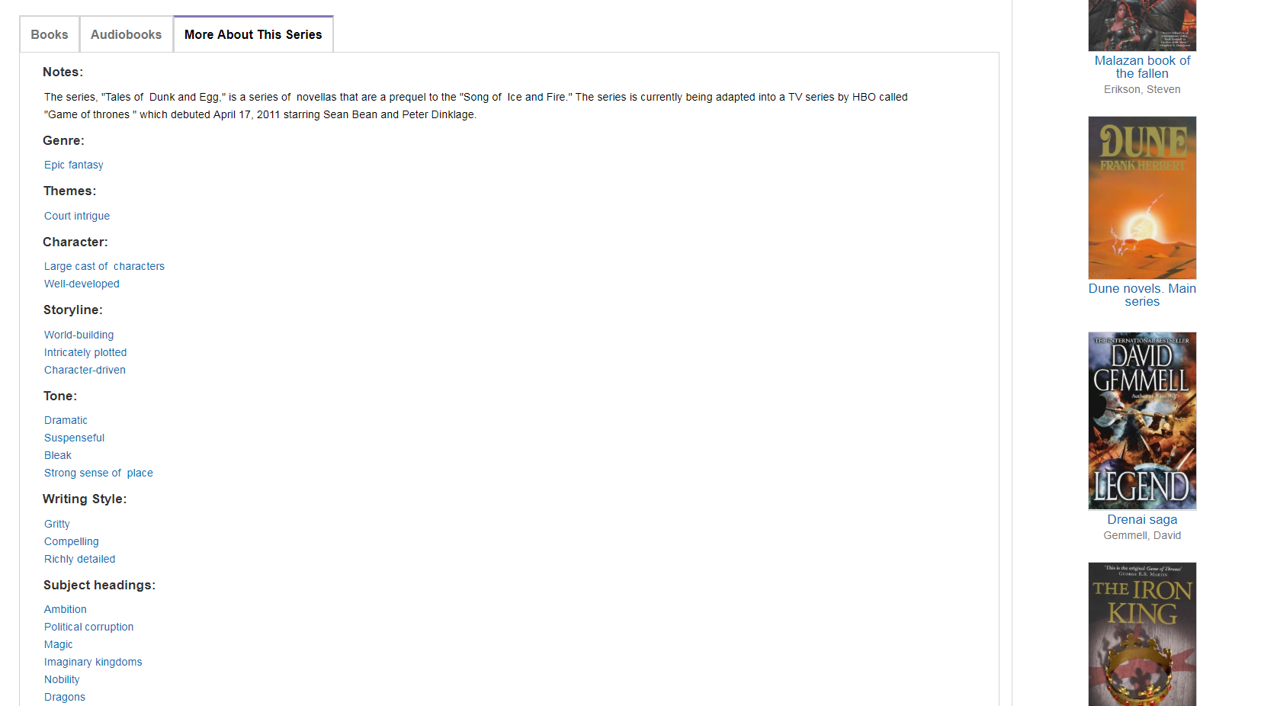
More About This Series

Slide 16
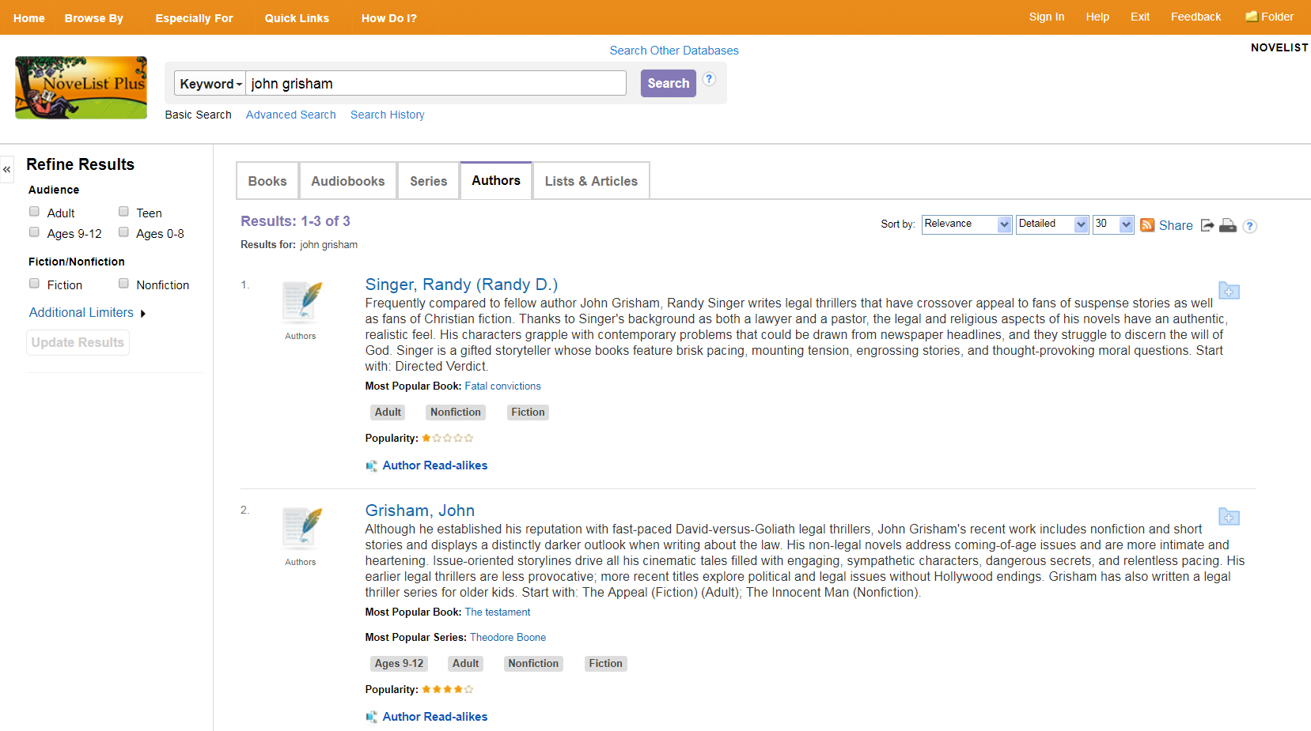
Searching for an Author
Enter your author name
Click the Authors tab
Select the author

Slide 17
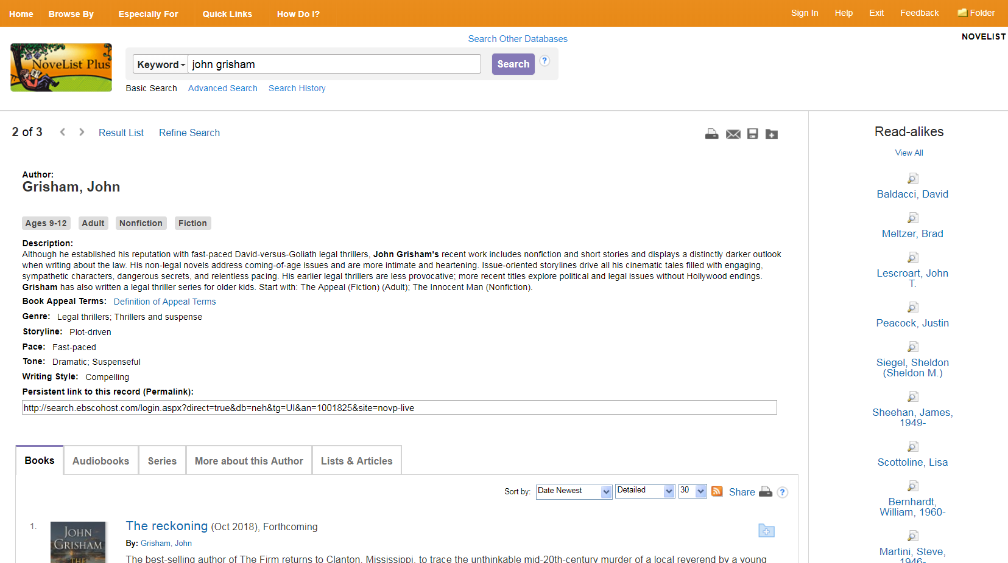
Author Details

Slide 18
Up to 9 read-alikes for an author

Slide 19
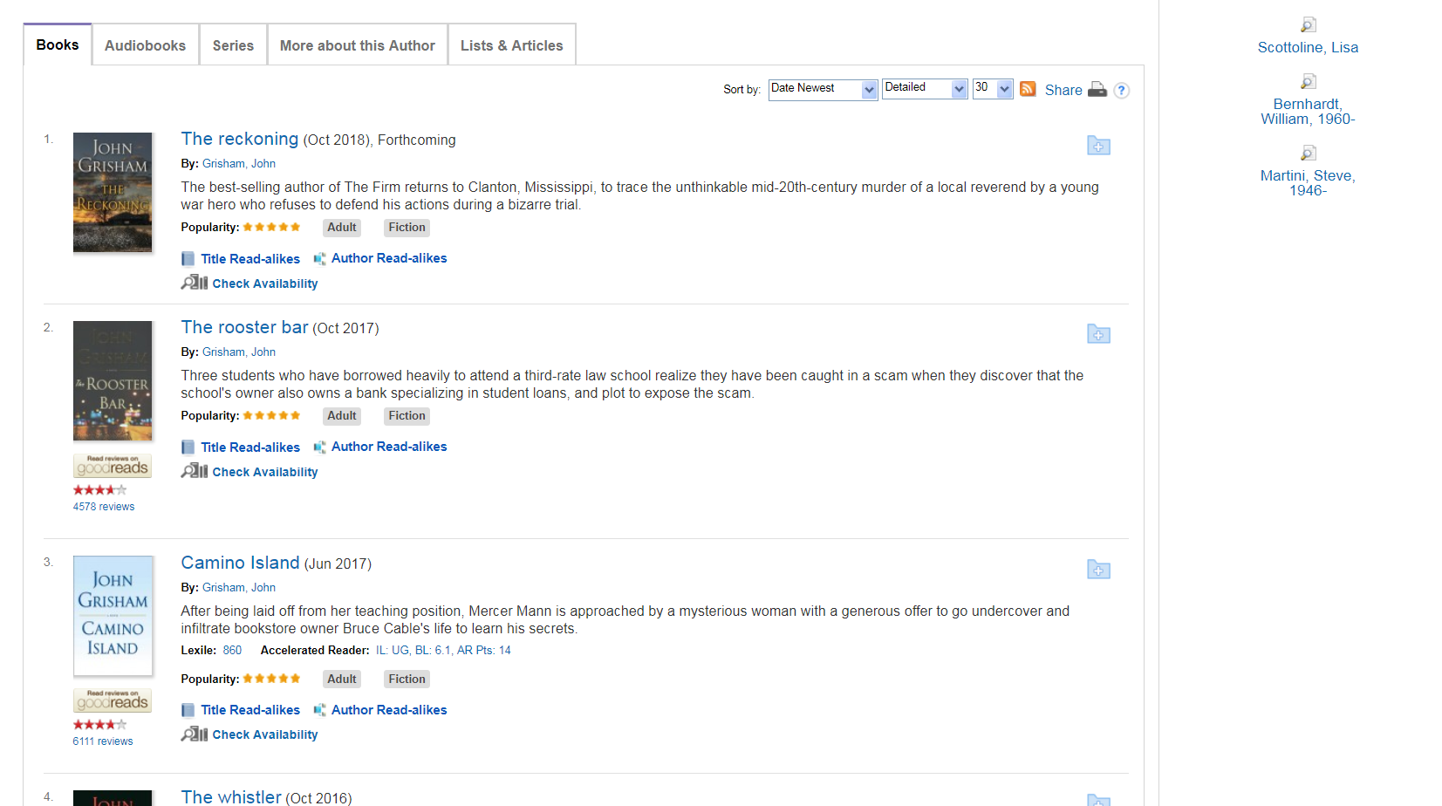
Other Author Information

Slide 20
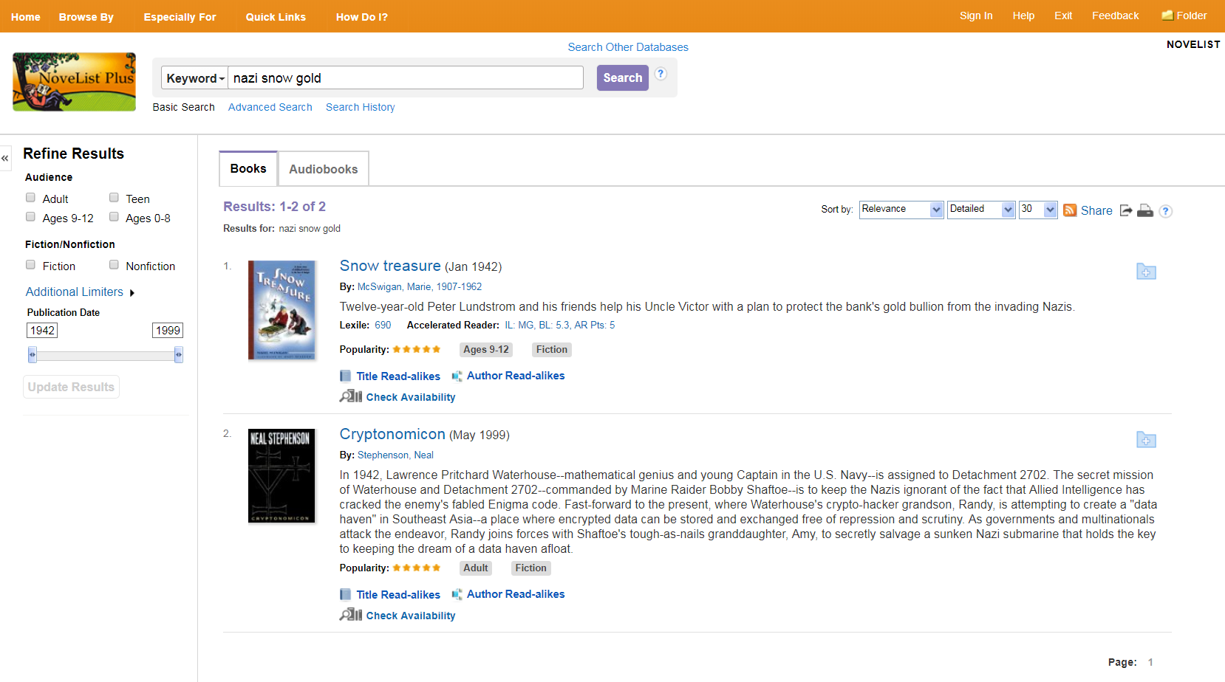
Searching by Keyword/Plot
Enter your keywords
Select your results
Refine your results, if necessary

Slide 21
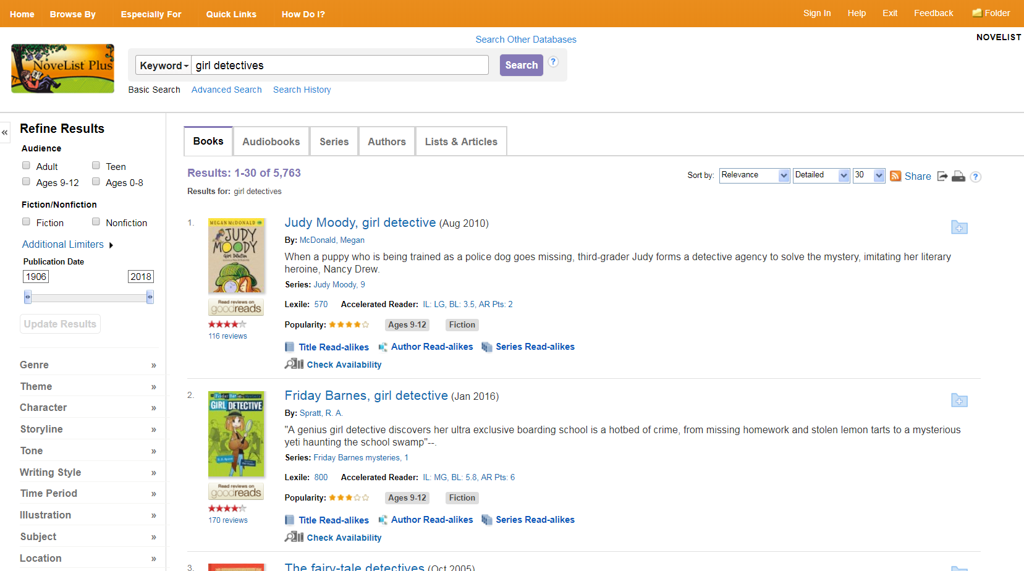
Viewing Results
View matching Books, Audiobooks, Series, Authors, and Lists & Articles
Refine your results
Narrow your results by key topics and appeal terms

Slide 22
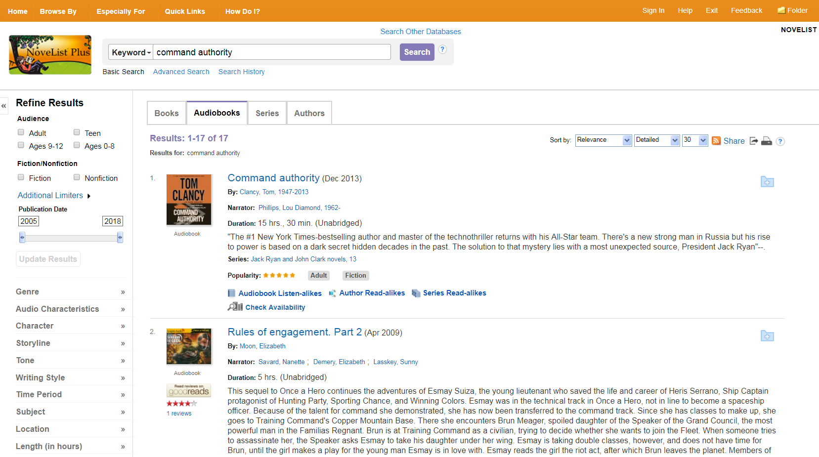
Searching Audiobooks
Enter your keywords
Select the Audiobooks tab
Select your results

Slide 23
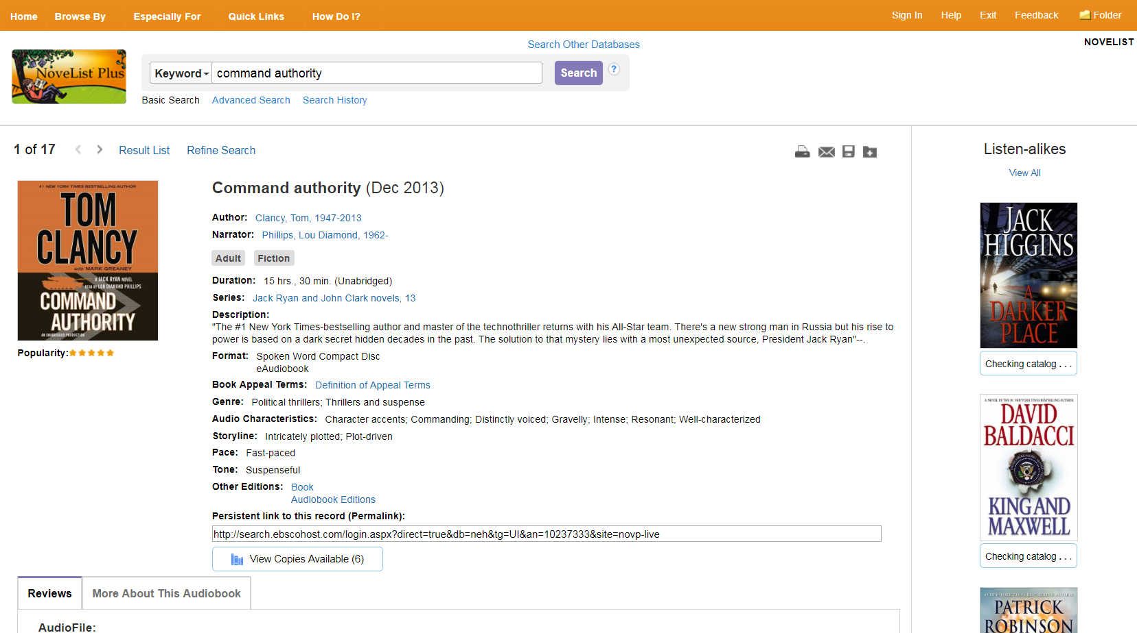
Audiobook Details
Up to 9 listen-alikes
Audio appeal terms

Slide 24
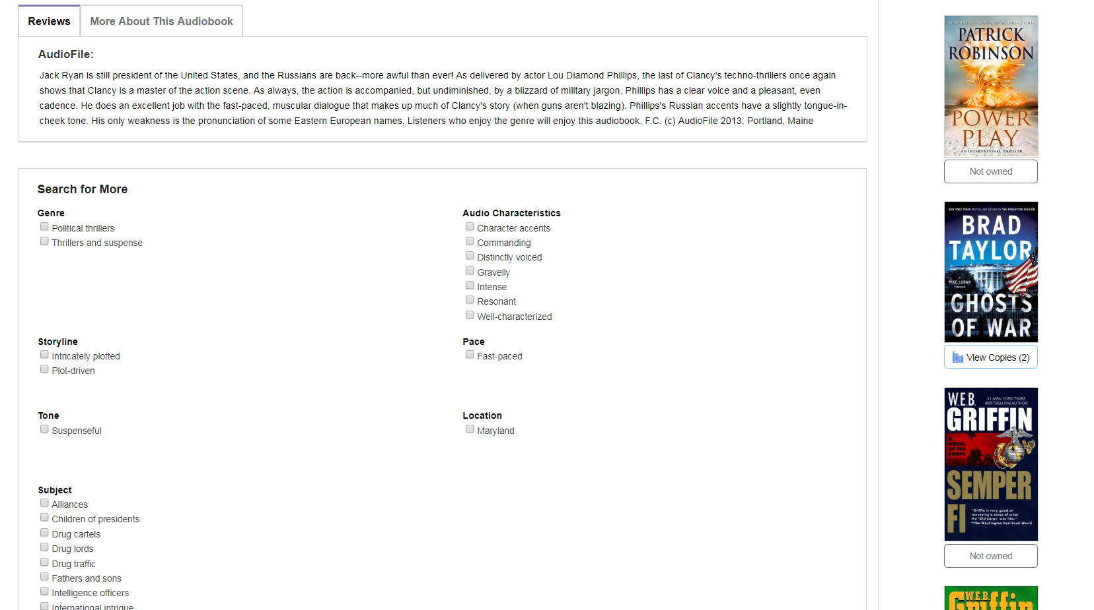
Other Audiobook Information

Slide 25
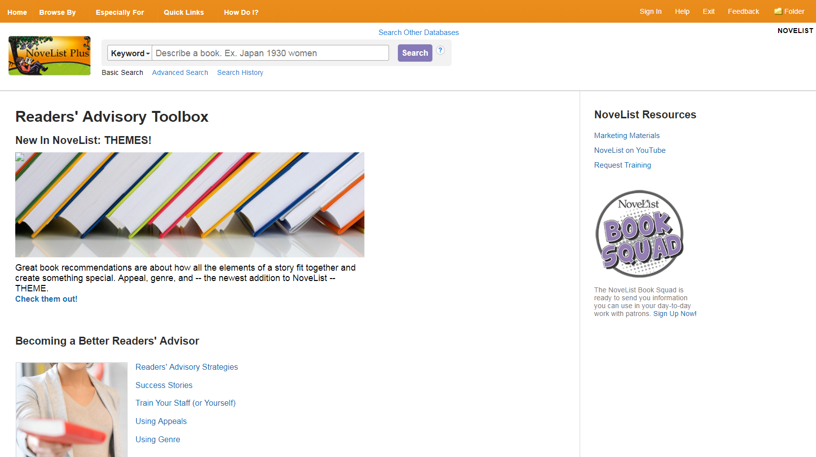
Readers’ Advisory Toolbox
Further training and resources
Featured content like seasonal inspiration
Book Squad email list

Slide 26
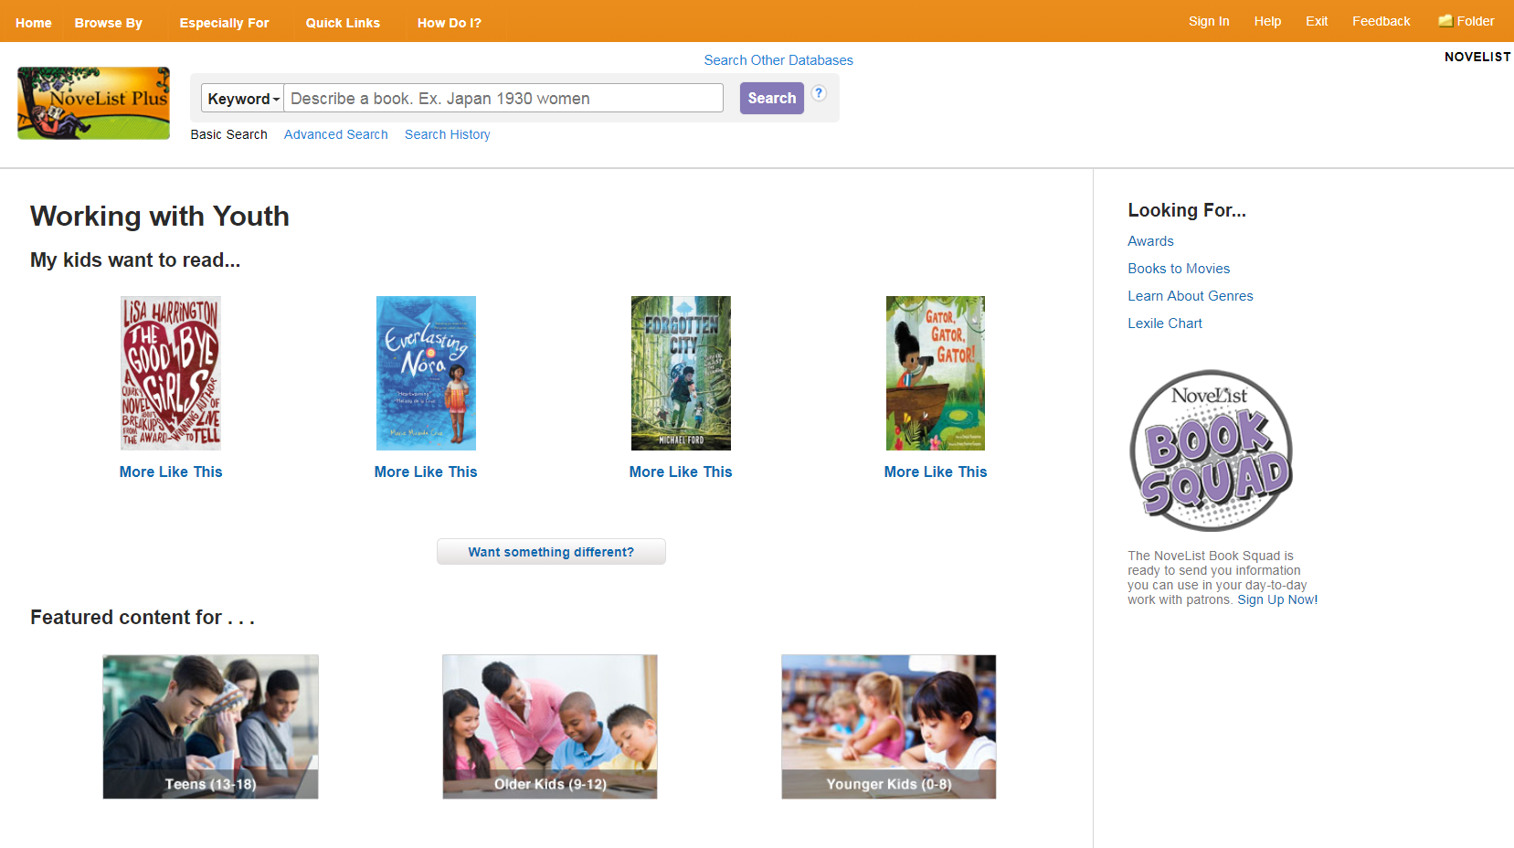
Working with Youth
Easy RA for kids and teens
Educational Resources

Slide 27
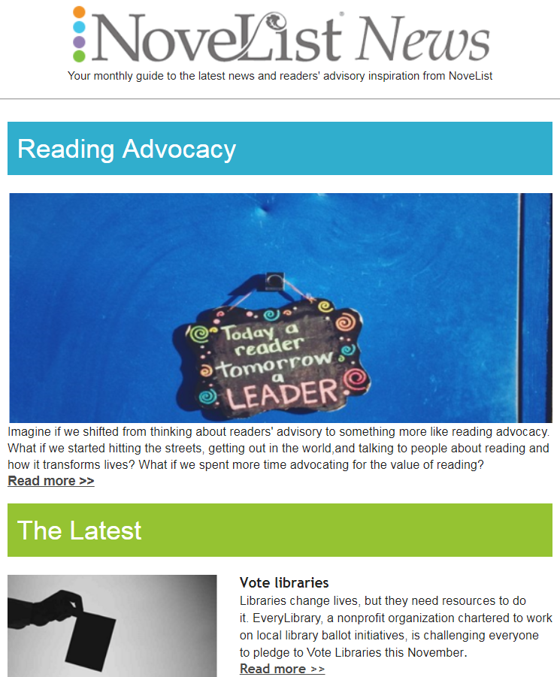
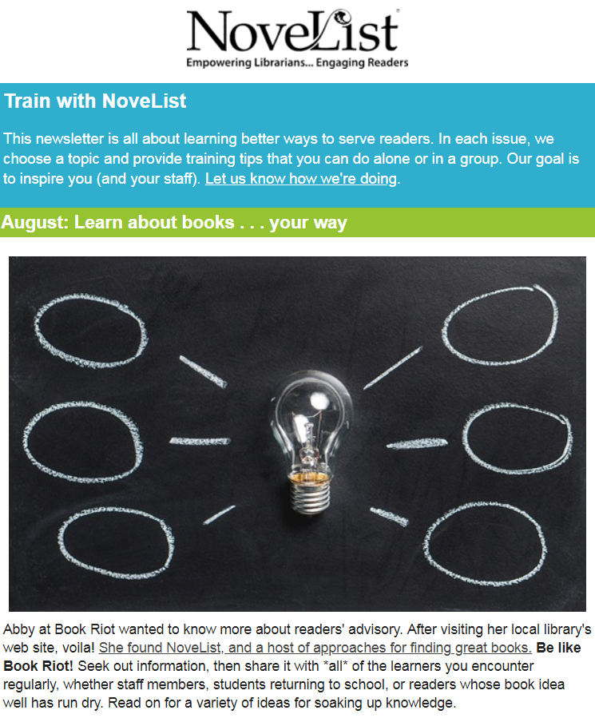
Sign up for free newsletters & emails
Subscribe at www.ebscohost.com/novelist/novelist-special/subscribe-to-newsletters

Slide 28
Thank You
Learn more at www.ebscohost.com/novelist
facebook.com/ebsconovelist
novelistra.tumblr.com
@novelistra
pinterest.com/novelist

