Slide 1
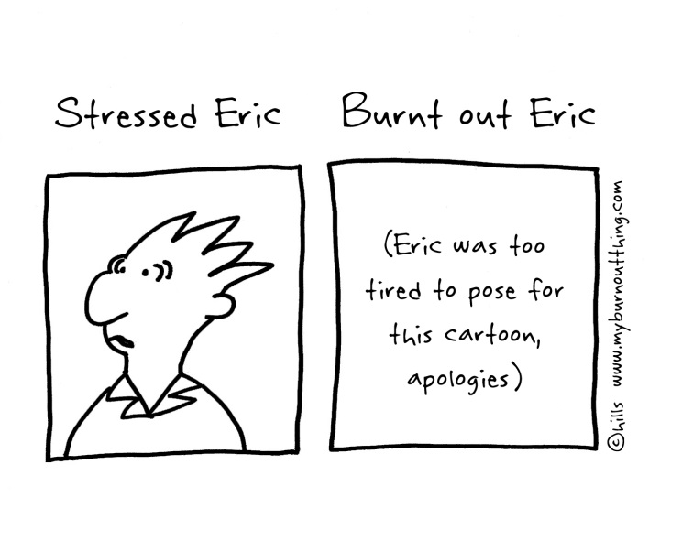
Serving Teens: Trying to Do More with Less (Without Burning Out)
Finger Lakes Library System
April 17, 2014
Notes:
First part will focus on partnering/collaborations…second part on advocating for resources…which are not always financial in nature.

Slide 2

9:30-12:00 (10:30/10:45 Break)
Introductions
Different Library Funding Sources
Why Care about Collaborating
Examples of Public/School Cooperation/Collaborations
Possible Obstacles to Partnerships
Brainstorming
Trustee/Board Roles
Advocacy
Notes:
Will probably be using cooperation/collaboration/partnership interchangeably…

Slide 3

Introductions
Notes:
Introduce self: Retail, Surgery, MLS Path, 14 Years, YSS/NYLA and YALSA/ALA: Committees and Boards; IPL Trustee/Library Vote; Founder and Director of TBF
Read description of workshop: Using current issues facing your libraries, Teen Services Librarian Stephanie Squicciarini will come armed with proven strategies and collaborative endeavors to help you serve your teens while also (hopefully) maintaining energy and enthusiasm! Bring your list of issues and we will together try to work out plans to make them seem less overwhelming. You will leave this workshop with strategies for school and public library collaboration and advocating for resources.
Go around and briefly introduce selves, why they registered for this, what they hope to get out of it

Slide 4

Notes:
Why? Sometimes our greatest resources and prevention to burnout are each other!
Your are NOT alone!
Use each other for job development/growth/ideas/collaborations
Avoid burnout by trying new things…reviewing for journals
It is okay to ask for help when unsure about something/lower comfort level…graphic novels/manga/technology

Slide 5
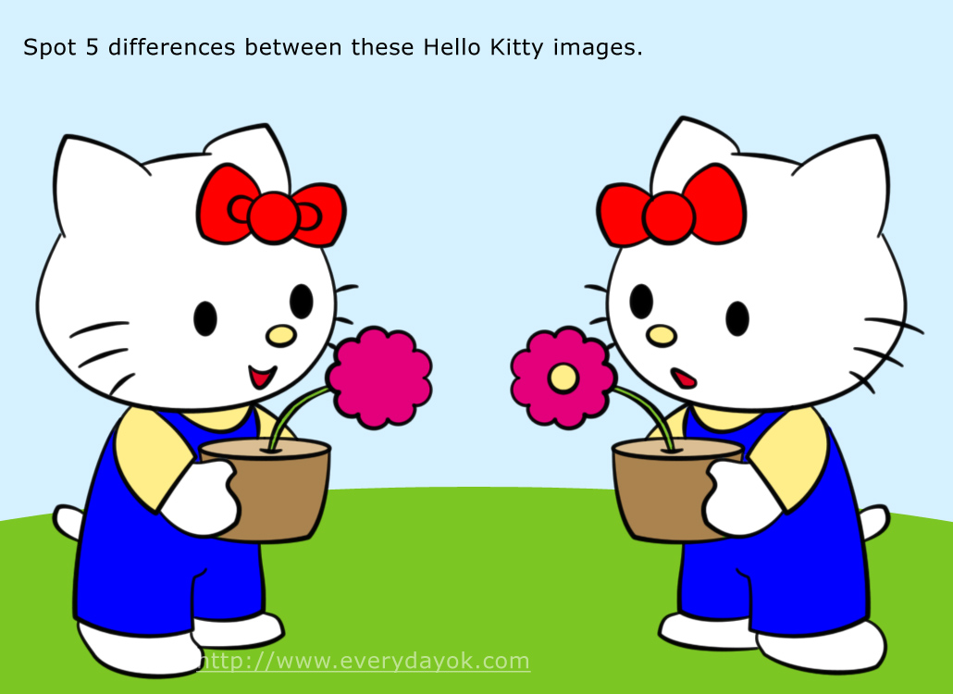
YA/Teen Services vs
Children’s Services
Notes:
Story of Miss Peggy…it can be hard to not get burned out/discouraged….teens not always as open with their appreciation of what we do…need to find ways to stay fresh and positive, celebrate the victories and learn from the not so victorious moments…

Slide 6

Celebrate Successes
Nothing wrong with “failure”
Learn from the tries
  Tweak or Abandon
  Never know what is possible until you try/ask

Slide 7

Different Library Districts
Budget/Funding Sources
How have yours impacted services to teens?
Equity of impact along other populations served?
Partnering/Collaboration can help avoid burnout AND with budget tightening!
Notes:
Sharing databases…poll your schools to see what databases they subscribe to.
Inventory the current NOVEL Databases.
What are you subscribing to?
Is their overlap/duplication?
Sharing passwords, if possible given licensing agreements, you might be able to avoid duplication and expand resources…Fairport Examples.

Slide 8

Why should we care about partnering?
Being asked to do more with less
Strengthen service to teens (and all patrons)
Stretch budgets by sharing
Make connections with community
Current and future voters!
Grants: Blessing or Curse or both?
Hopefully avoid burnout by sharing load!
Notes:
Management class in library school. Did he lie? Was it different then?
School students who see you working on their behalf…future voters!
Parents will hopefully make the connection…current voters!
Town/County/State make the connection (more on these in advocacy portion too)
Name/Organization recognition in community…think about partnering beyond library walls…local business/programming…Kaplan Test Prep, Fencing Club, Chess Club, Music Stores, etc.
GRANTS: Existing and proven partnerships can make them “easier” to get
Don’t look for grants to close budget gaps…or use to create new programs that can add to burnout. Too often town governments and even boards make this mistake. Example of IPL Board…told by town officials to look for grants to help with budget woes…avoiding their responsibility to fund the library!

Slide 9

Examples of Public and School Library Cooperation/Collaborations
Notes:
Refer to handouts.
Some needs to successful collaborations:
Commitment
Mutally
Examples from group?

Slide 10
Some Common Threads to Successful Partnerships/Collaborations
Agreed upon/realistic goals
Clarity and Commitment
Joint planning
Continuity
Feedback and flexibility
Open/Honest communication

Slide 11
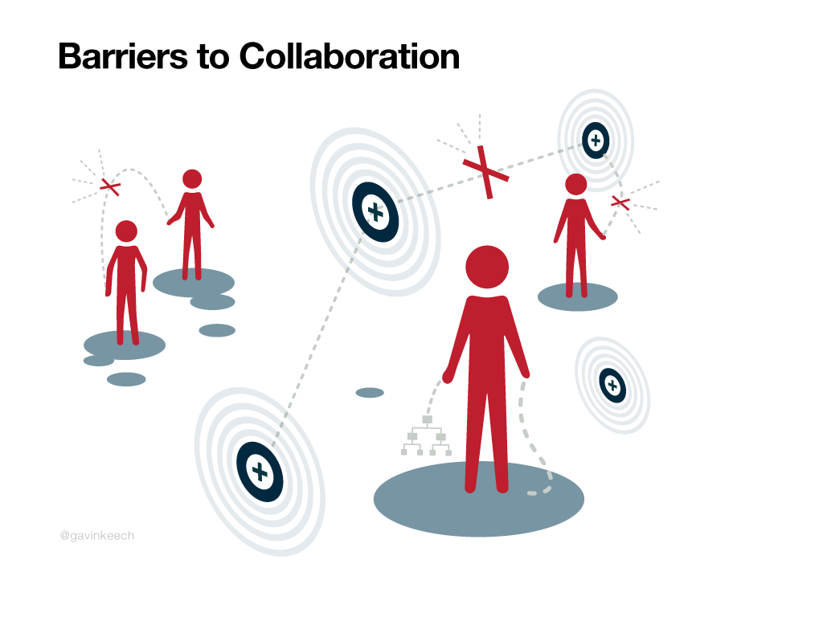
Possible Obstacles?
Notes:
What are some possible barriers/obstacles?
Ourselves?
Not our problem?
Not their problem?
TIME!
We will talk about overcoming some of these obstacles after our breakout groups!

Slide 12

Brainstorming!
Possible Partnership
Outcomes/Goals/Why try?
Possible obstacles
Solutions to obstacles
How implement and nurture/timeline?
Measure of success?
Notes:
Partnership can be something you have already tried. Ask group on how to tweak it? Or time to abandon it?
Groups will present their case study.

Slide 13
Role of Administration/Boards
Budget for conferences, networking/training opportunities
Support professional memberships
Allow time, even if no $
Write into job descriptions
Monthly Reports
Notes:
What can we ask of our boards? I know many of these are way easier said than done!
We now include collaboration efforts on our monthly reports to the Board.

Slide 14

Advocate for your teens!
And for yourself!
YOU CAN DO IT!
Local/Everyday Advocacy
Keep statistics!
Keep staff, administration, boards informed
YALSA tools
Notes:
Monthly reports to Boards…

Slide 15


